Slide 1


Welcome to Batley Parish J, I and N School
Twitter- @BPNursery1
www.Batleyparishpri.kfgl.dbprimary.com
School office- 01924 326361
Naadhirah.Chothia@Kirkleeseducation.uk

Slide 2


All About US Batley Parish Nursery is a 65 place Nursery. We pride ourselves on learning through play and believe this is how the children meet their highest potential. We are very proud of our Nursery and our Early years team and we hope you feel this evening answers any questions you may have.
Meet the team
The Early Years Curriculum- How and what does my child learn?
What hours do we offer?
Absences
Settling in
How can I help at home?
Any questions?

Slide 3
Our Early Years Practitioners
Miss Dack will be on maternity leave until later in the academic year.
Mrs Lunat will be the Early Years practitioner in Nursery.
She is trained to deliver speech and language support.
Miss Chothia will be your teacher and will also be the Nursery Manager.

Slide 4

Christian Values
Our rich diversity means that we can learn from each other every day and hold true to our school values of love, friendship, compassion, equality, trust, respect and forgiveness. Our motto: 'Together We Are One‘ is fundamental to the Christian ethos of the school and to other religious beliefs and customs.

Slide 5
The revised Early Years Curriculum What are the changes and how will this affect my child’s education?
Aims to strengthen your child’s language and use of vocabulary.
Staff are to use checkpoints in 0-3 and 3-4 years to quickly identify any children who may need additional support or interventions to get them to the age related expectations.
The revised EYFS curriculum came into effect from September 2021
The 7 areas of the curriculum have remained the same.
There is a huge change in the way we observe our children. Our time will be spent with your children and teaching meaning that less time will be spent observing.

Slide 6
The revised Early Years Curriculum What are the changes and how will this affect my child’s education?
Revised Early Years Foundation stage curriculum came into effect from September 2021
Aims to strengthen your child’s language and use of vocabulary.
The curriculum is organised into three stages; birth to 3, 3-4 years (Nursery/Foundation 1) and Reception Year.
Staff are to use checkpoints in 0-3 and 3-4 years to quickly identify any children who may need additional support or interventions to get them to the age related expectations.
Seven areas of the curriculum- these have remained the same.
There is a huge change in the way we observe our children. Our time will be spent with your children and teaching meaning that less time will be spent observing.

Slide 7
Prime Areas of Learning
Personal, Social and Emotional Development
Self-Regulation, Managing Self and Building Relationships
Communication and Language
Listening, Attention and Understanding and Speaking
Physical Development
Gross Motor Skills and Fine Motor Skills
Specific Areas of Learning
Literacy
Comprehension, Word Reading and Writing
Maths
Number and Numerical Patterns
Understanding the World
People, Culture and Communities, The Natural World and Past and Present
Art and Design
Creating with Materials and Being Imaginative

Slide 8
What and how does my child learn at Nursery?
Your child will learn through play and exploration.
The classroom is well planned and carefully resourced to support and enable their learning and development. Children have access to a fantastic outdoor area
Your child will learn through exciting stories and topics
Your child will receive a daily phonics, counting and story session.
Your child will be taught in small group activities

Slide 9
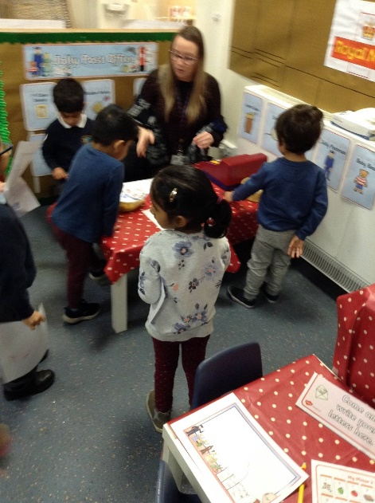
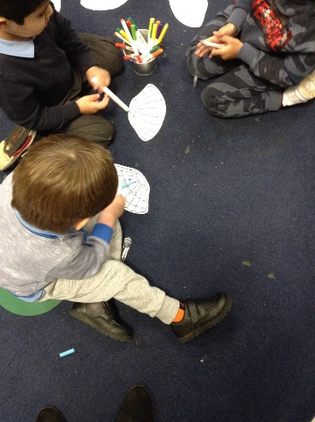
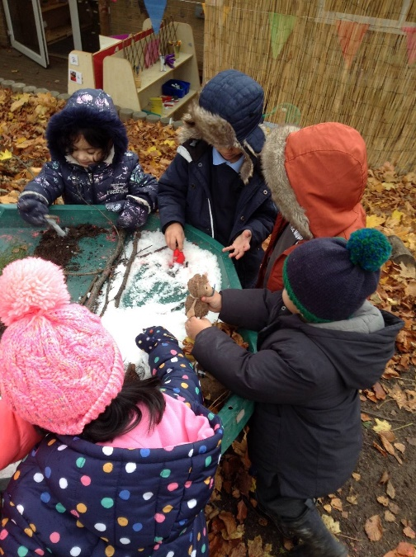
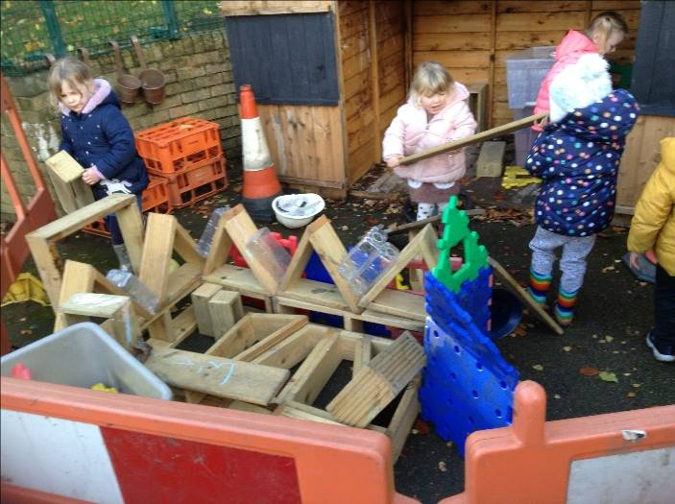
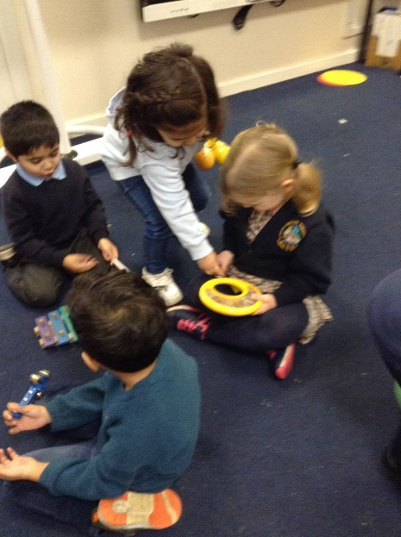

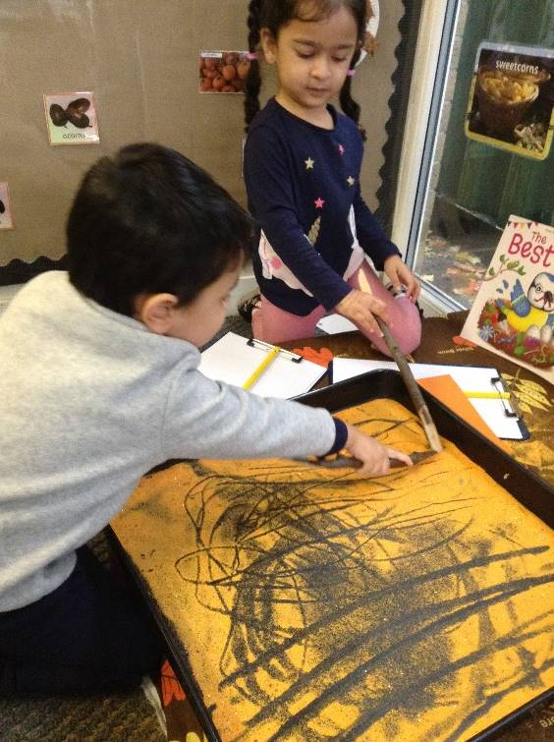
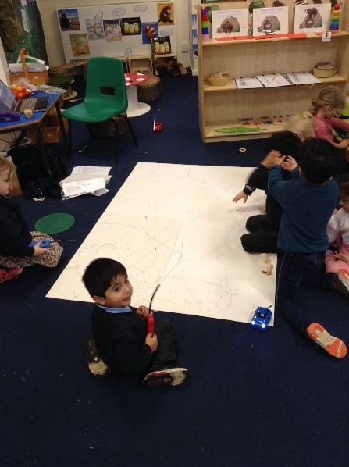
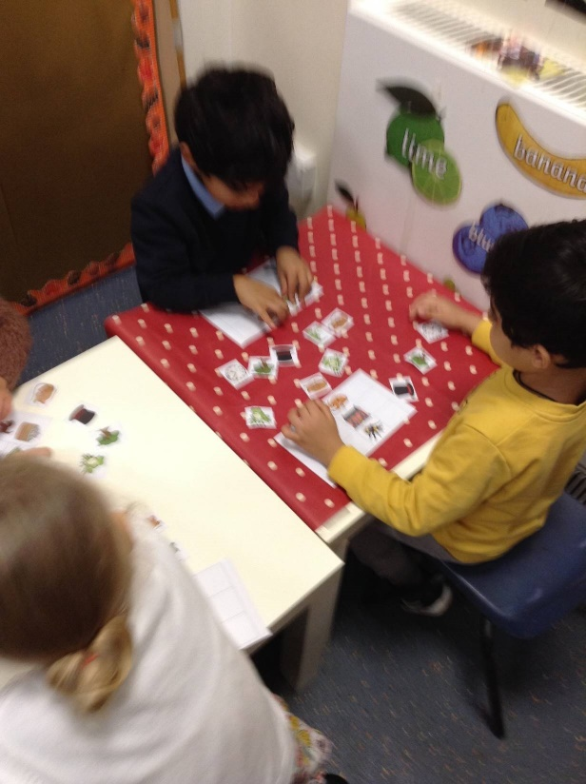
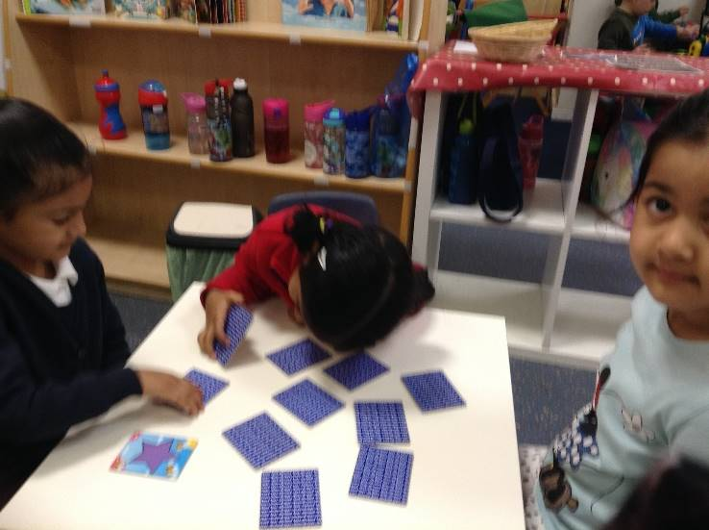

Prime Areas of Learning

Slide 10
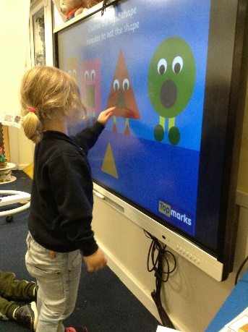
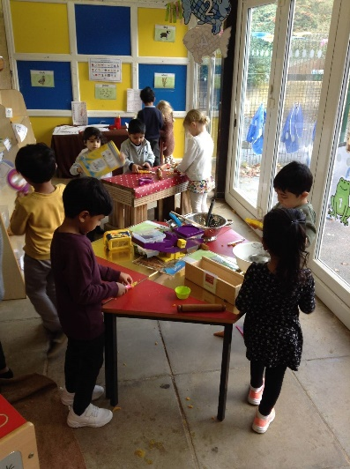
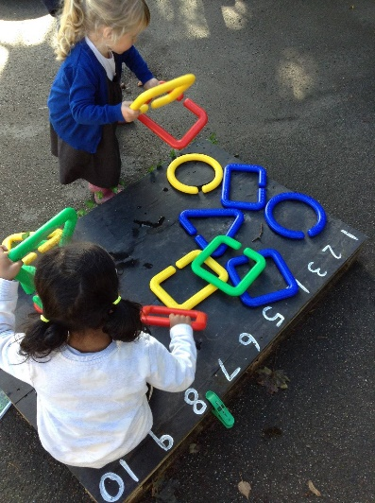
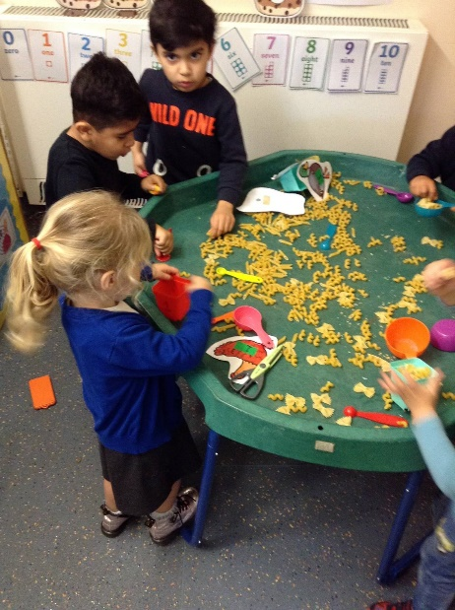
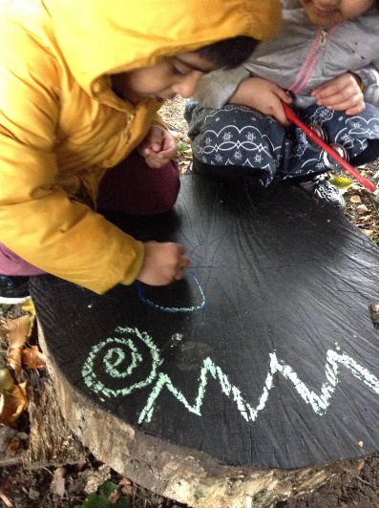
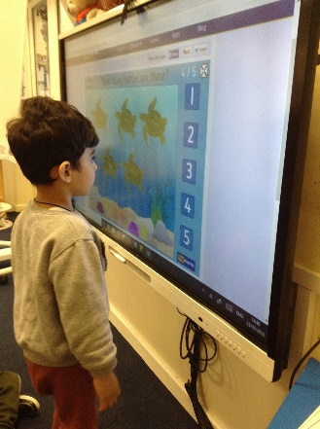
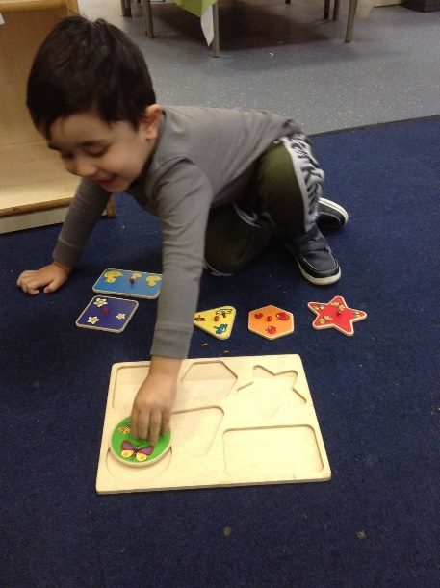
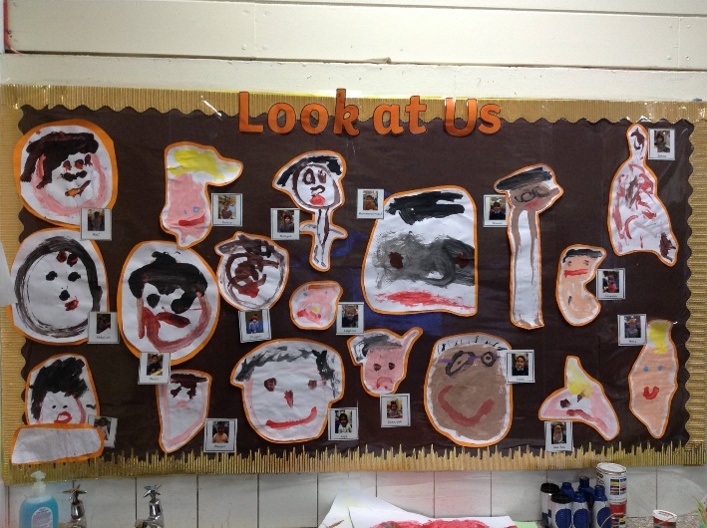
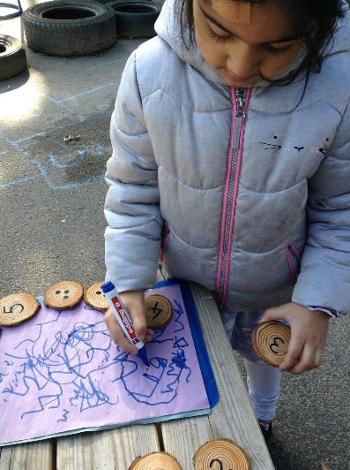
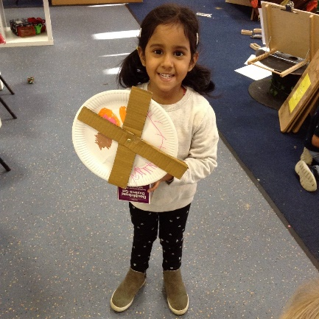
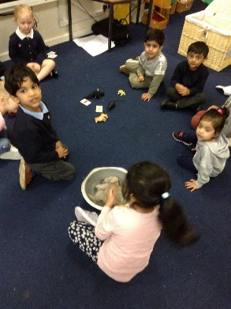
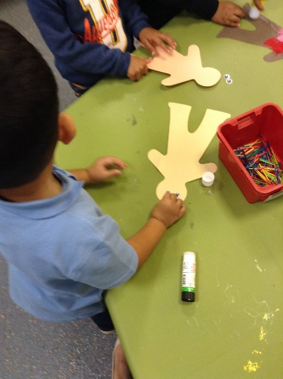
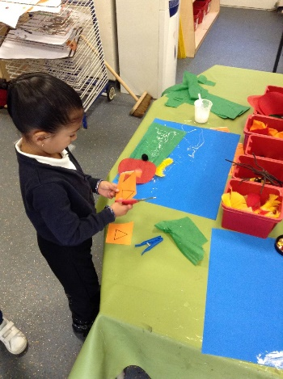
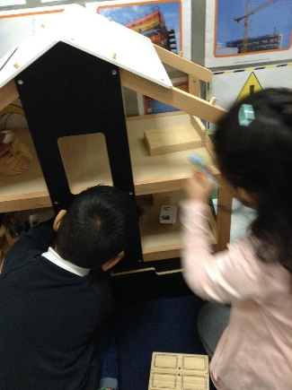
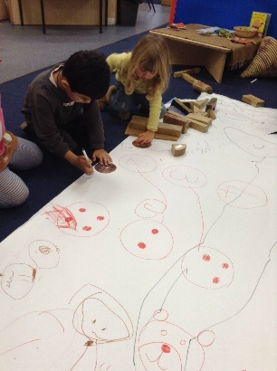
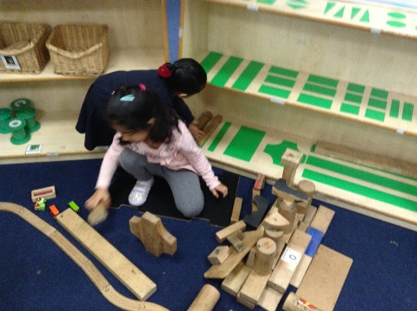
Specific Areas of Learning

Slide 11
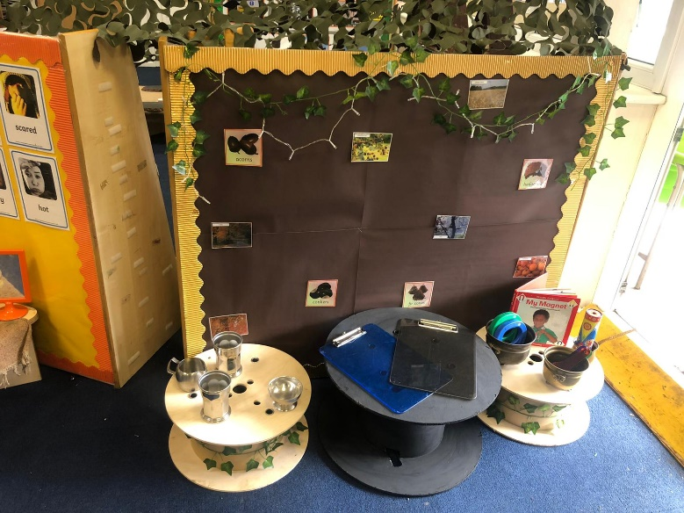
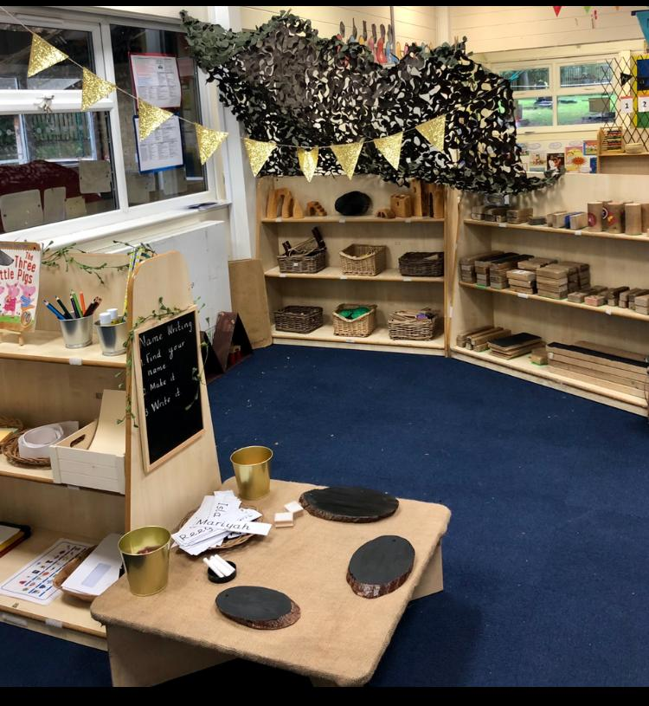
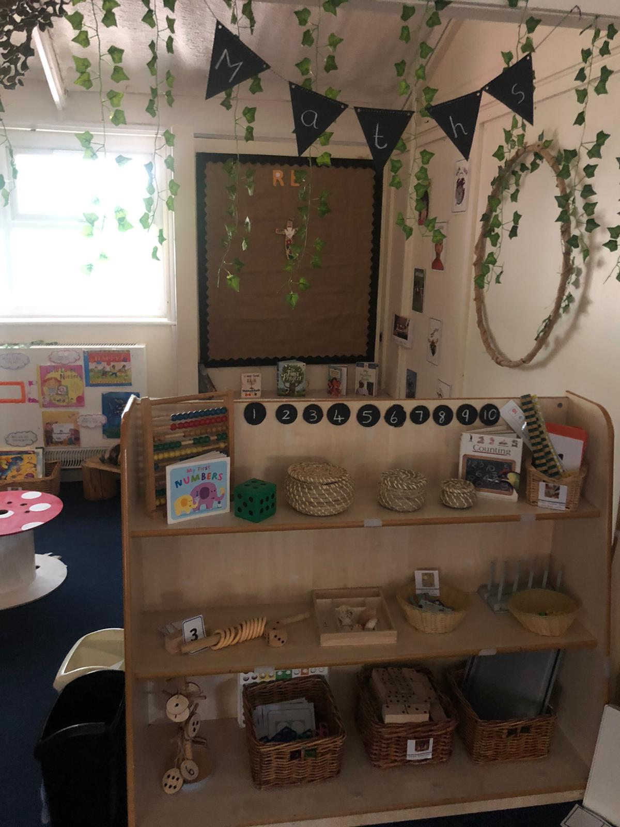
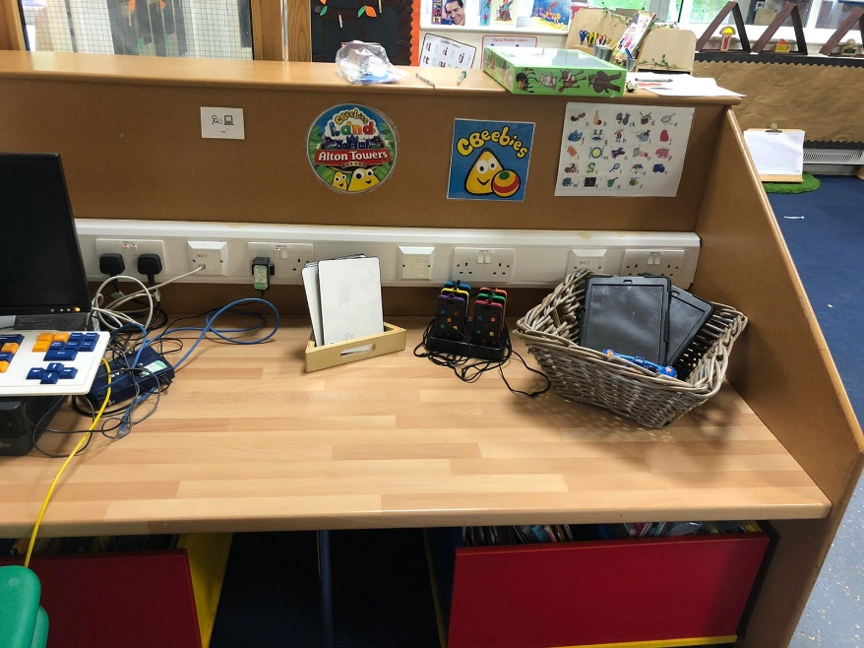
Some of Our Fantastic Provision Indoors

Slide 12
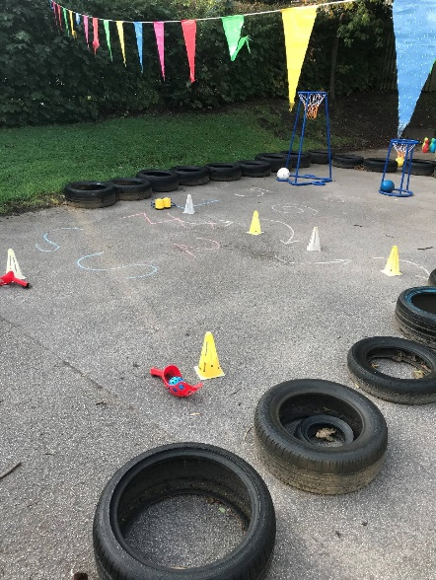
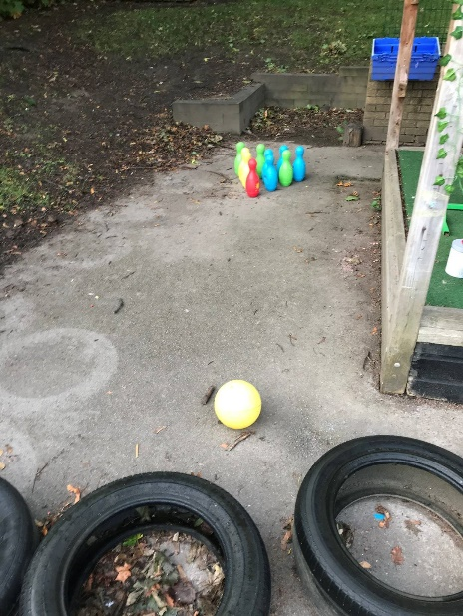
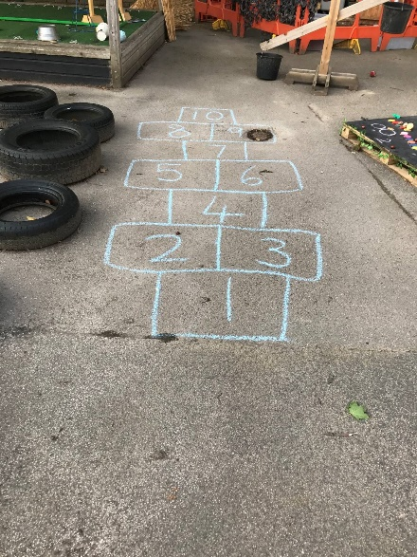
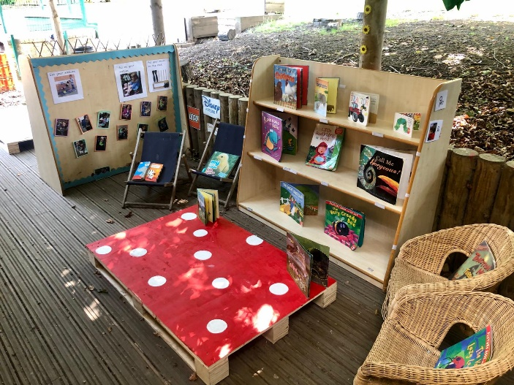
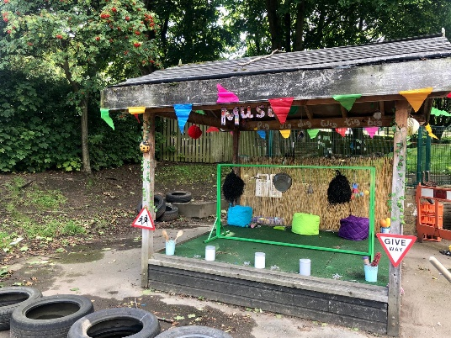
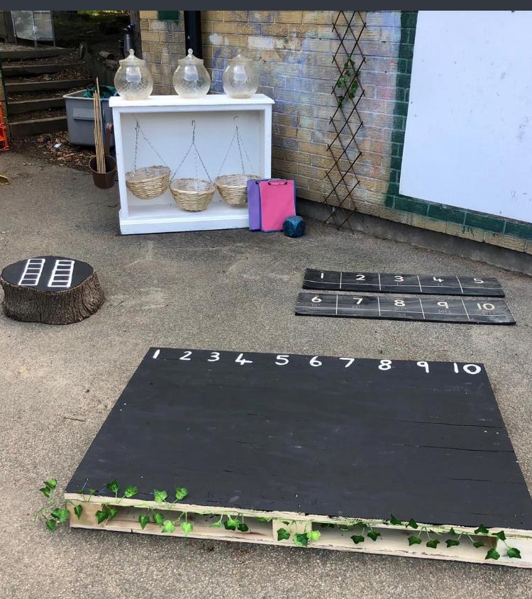
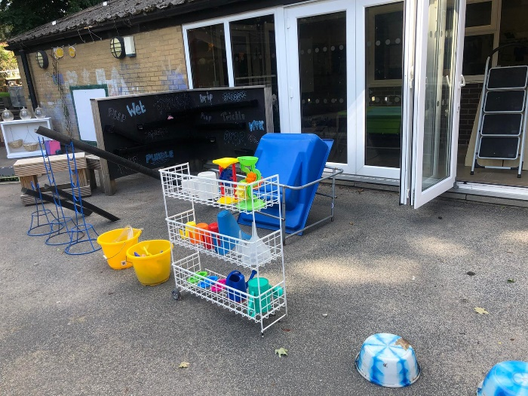
Some of Our Fantastic Provision Outdoors

Slide 13
15 Hour Nursery Place
All 3 year olds are entitled to 15 hours.
Option 1
A daily morning session. This session is every week day morning 9:00am - 12:00pm.
Option 2
A daily afternoon session. This session is every week day afternoon 12:00pm-3:00pm.
Option 3
A flexible place. This option is usually taken across 2.5 days. A full day session runs from 9:00am - 3:00pm and the children stay for lunch. We would recommend taking this session in a 2.5 day block for continuity for your child.
.

Slide 14

30 Hour Nursery Place
As a family you need to be eligible for the 30 hours. Every three months you will be required to present the school office with a code to continue your eligibility. Please see our 'Partnership with Parents' page on the website for more information or the government help with childcare website.
These hours are every day (Monday-Friday) 9:00am-3:00pm.
Lunchtimes
Lunchtime is supported by an Early Years Practitioner and a lunchtime supervisor. We use this time to continue fantastic learning! There is an option for a school lunch which can be paid for through our online Parent Pay or you can provide your child with a packed lunch.

Slide 15
General Information
Fruit, milk and water is provided every day for the children, free of charge. We kindly ask that you provide your child with their own named water bottle each day.
There is a story or songs to end each session.
Once the children are settled there will be a daily phonics and group time session.
Please arrive promptly at the start of each session
Each week we ask for a voluntary donation of £1.00 This supports our messy learning, playdough, resources based on the children’s interests and helps to provide baking ingredients.
We learn indoors and outdoors everyday. Please ensure your child has appropriate clothing.

Slide 16
Absences
Whilst we recognise that whilst Nursery education is not compulsory, we cannot stress the importance of your child coming to school daily. However, should your child not be able to attend please follow these procedures;
If your child is unwell please contact the school office each day of your child’s absence. Contact 01924 326361
If your child has a dental appointment, then please provide a copy of their appointment card.
All holidays taking during term time need to be authorised a holiday request form must be completed.

Slide 17
Home Visits
Your children should have been given a date and time for the home visit. This is where two members of the nursery team will come to your home. It will be a lovely opportunity for us to get to know your child and find out all we can about them and for them to meet us.
First Day
You should have received a start date. This will be clarified on your visit/meeting to nursery. Your child may be teary on their first day but please leave promptly. We will always call you or arrange a sooner pick up if necessary. We like the children to know families leave but they always come back, even if that means 30minutes later on the first few days, or until they have settled.

Slide 18





What does your child need to bring to Nursery?
Please wear old clothes or school uniform that is named.
Spare clothes (including socks).
Waterproof coat.
Appropriate clothing for the weather (hats, gloves, scarf or sun hat).
Named wellies to leave at nursery.
Any medication your child has, for example, an inhaler.
£1.00 class fund donation
Named water bottle.

Slide 19
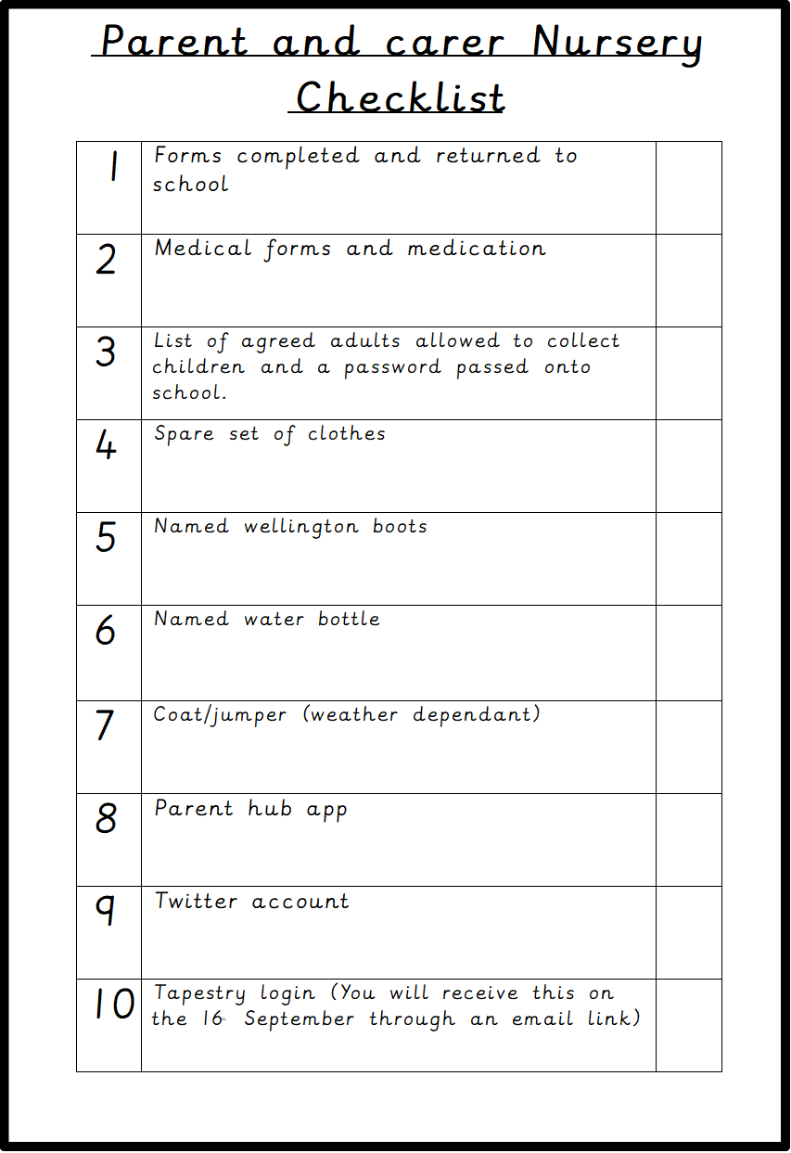

Slide 20
Prime Areas of Learning How can I help my child at home?
Help children to get dressed and undressed.
Playing games which encourage sharing and turn taking.
Using a knife and fork.
Share class rules.
Encourage your child to become independent.
Read and share stories to your child that have a rhyming pattern or predictable text.
Allow your child time to answer how and why
Introduce new words to them
Be a good role model
Model speaking in full sentences
Give children time to run, jump, climb and play outdoors. Go to the park and get outdoors!
Encourage children in activities such threading, baking, playdough, lego, drawing, scissors and tools all of which develop manipulative skills.
Toilet train your child before they start with us.
Encourage your child to put on their own coat and shoes (Velcro shoes are fantastic!)

Slide 21
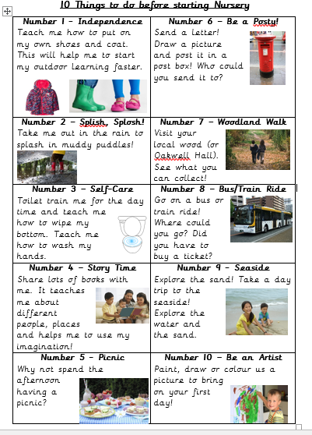
This is on our website.
Go to Batley Parish School - Nursery – Starting Nursery

Slide 22
How can families support learning?
We are eager to include families in learning as often as we can and welcome your involvement!
Tapestry
We add to an online learning journey and you will receive a login for this. We would welcome you to send pictures of things your child has done at home or whilst with family. This is also where we will give you home learning ideas each week.
Parent Hub
Please download the Parent Hub app to access any letters and information sent out from school. This is how we will send our monthly newsletter update.
Twitter
We share a Twitter page with the Nursery class. On here you will be able to see some of the lovely learning activities your child takes part in. there is a sheet in your child’s pack explaining how to follow us. @BPNursery1
Mystery Reader
This is a chance for you to surprise your child by coming and reading their favourite book to the class.
Stay and Play Sessions
At Christmas, Easter, Eid and the end of the year we will hold a stay and play session. This is a chance for you to join in some themed activities with your child. The dates for these will be given once your child has started.
Library Day
Every Wednesday your child is asked to choose a book from our library box to bring home. Their book bag will be returned the following day.

Slide 23
Any Questions? Let’s take a look at Nursery!

